Slide 1

The Economics of the health service
Ulster University Economics School Conference
Áine Doran
a.doran@ulster.ac.uk

Slide 2
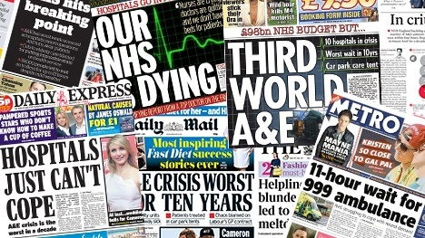
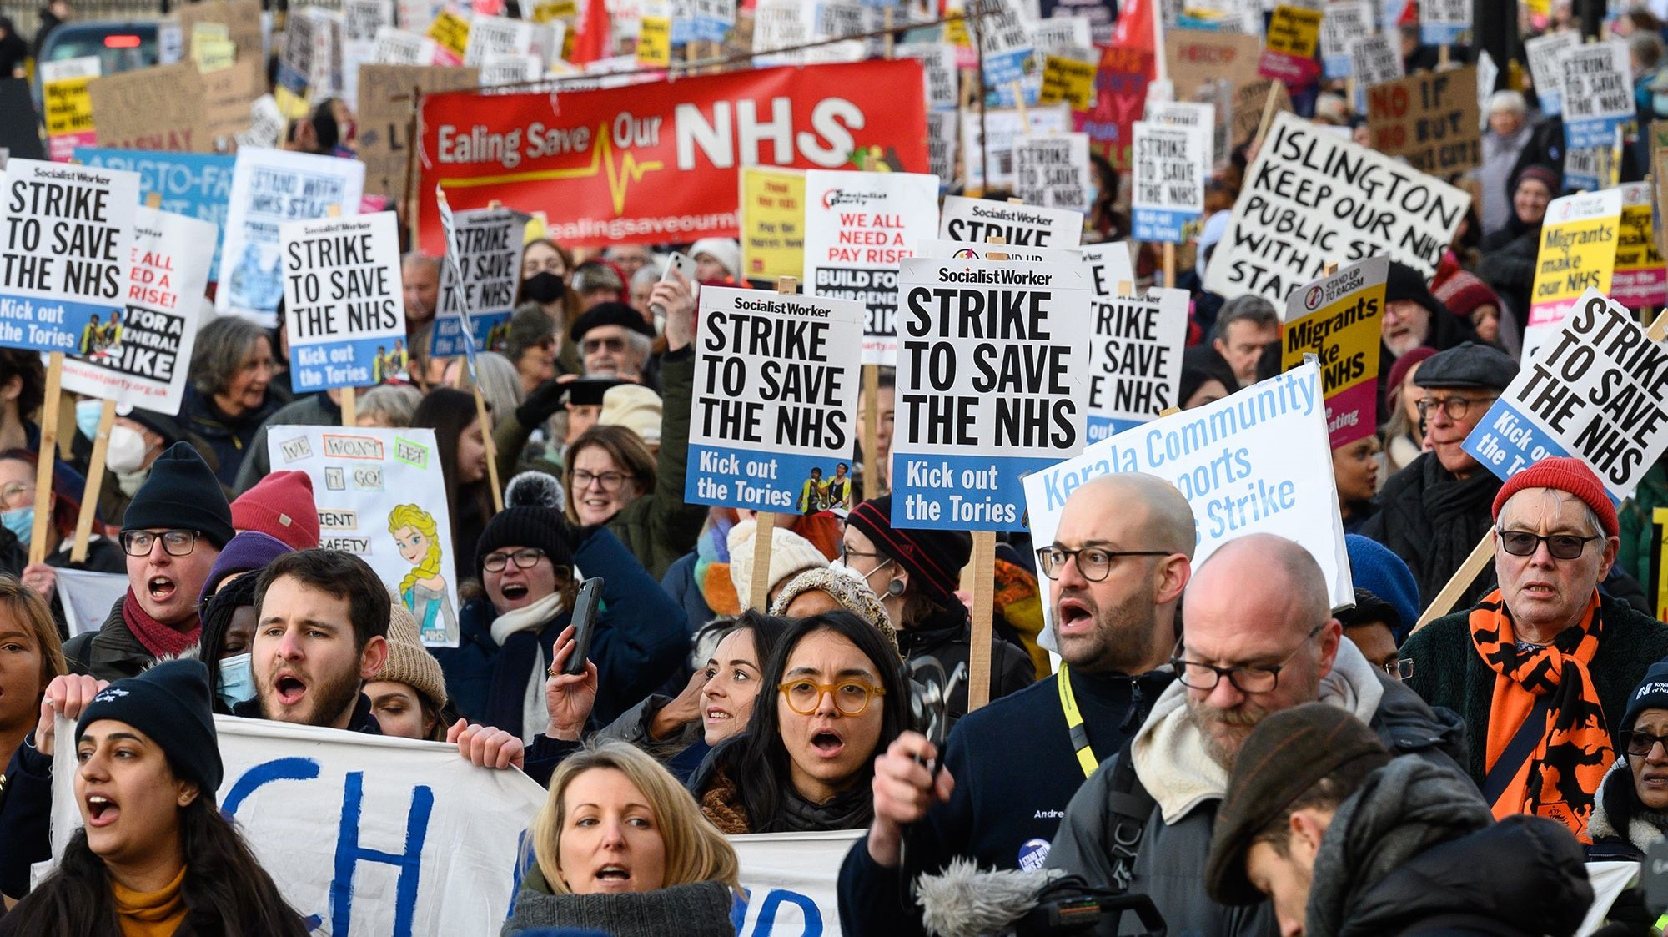
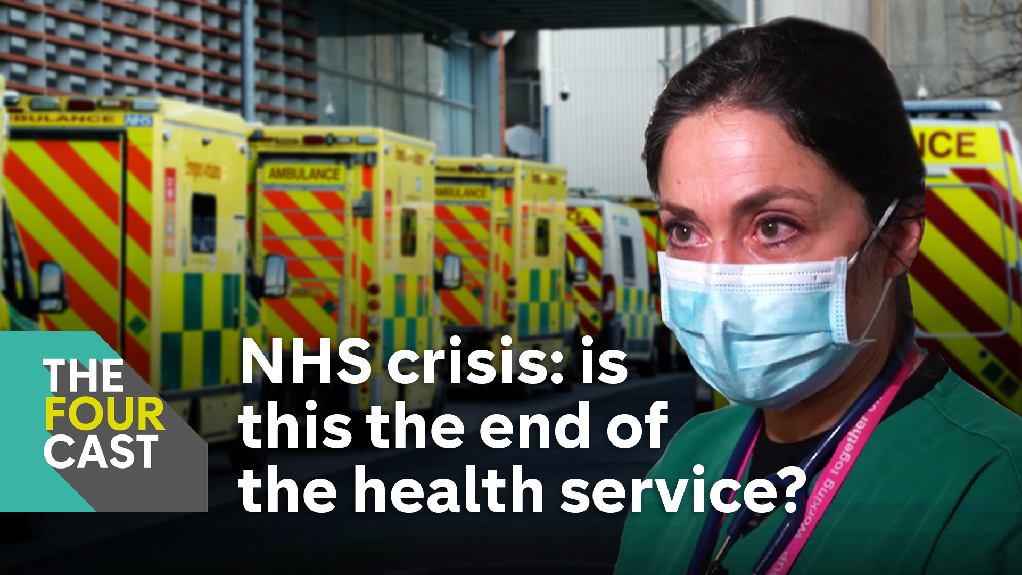
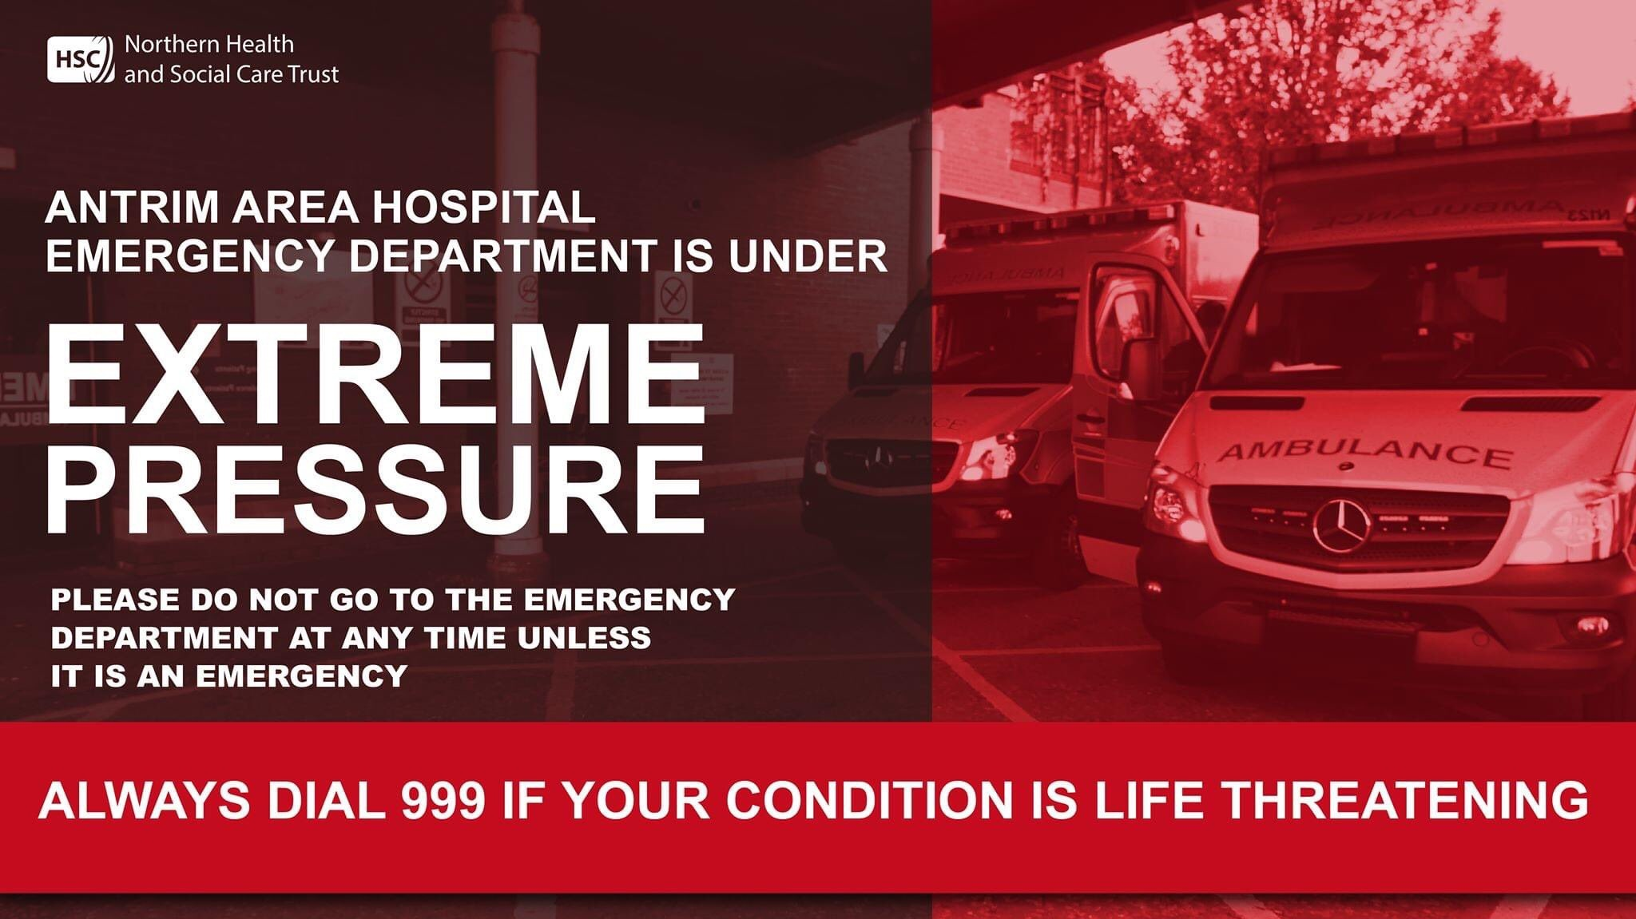

Slide 3

Brief History of the NHS
Created in 1948
Aimed to provide free and universal access to healthcare (one of the first in the world)
“It will provide you with all medical, dental and nursing care. Everyone — rich or poor, man, woman or child — can use it or any part of it. There are no charges, except for a few special items. There are no insurance qualifications. But it is not a “charity”. You are all paying for it, mainly as taxpayers, and it will relieve your money worries in time of illness.” — Central Office of Information, for the Ministry of Health (1948)
UK’s largest employer, approx. 1 in 35 of the working population is an NHS employee
In 2022/23 the Department for Health & Social Care in England spent £181.7 billion
2024-25 budget for health in Northern Ireland was around £7.8 billion (more than half of Stormont’s overall budget)
Notes:
https://www.nhs70.org.uk/about/background#:~:text=The%20NHS%20was%20created%20in,overwhelming%20majority%20of%20the%20public.

Slide 4
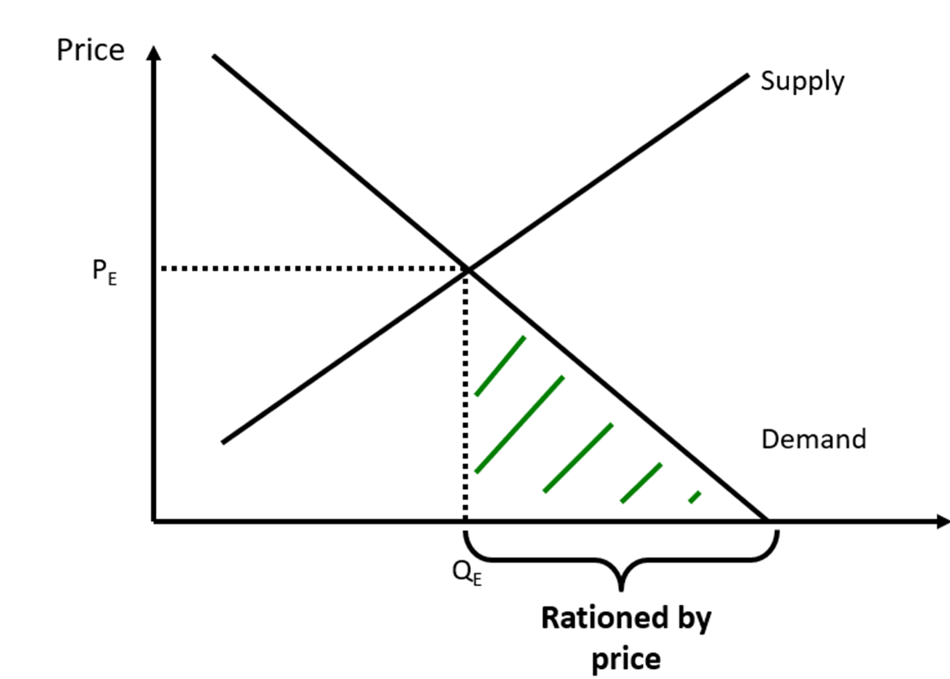
Dealing with unmet demand
In a free market e.g. cosmetic surgery
Any quantity demanded above Q_{E} will not be supplied as the suppliers are not willing to produce at this price
The green shaded area therefore represents the people who are being rationed by price

Slide 5
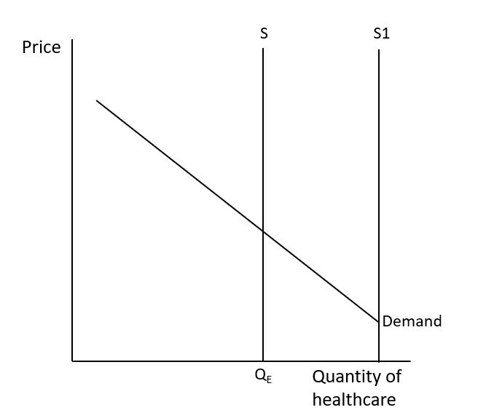
Dealing with unmet demand
However, in a free at the point of use public health system supply is not upward sloping
It is set at Q_{E} by budgets and will be vertical at that point
Unlikely that supply will ever be at S1 so there will always be some amount of unmet demand that is not rationed by price

Slide 6
Demand pressure on the NHS
Growing Population
  The overall population of NI is projected to rise from 1.86 million to 2.06 million (10.3% rise)
Aging Population
  The over 70 population is projected to rise from 208,000 to 457,000 (119% rise)
  For the over 90s it is nearly a 600% projected rise
  By 2027, NI will have more pensioners than children
  Working age population will start falling from 2028
Rising Health Awareness
Long-term effects of COVID
Rising Mental Health Crisis
Income Inequality
  Up to 10-year gap in life expectancy between regions and income groups

Slide 7
Supply pressures on the NHS
Budgets aren’t increasing in line with the increases in demand
The NHS has to try and get more value from the same budget
  In 2012 the NHS had to get £15-20 billion more value from the budget due to increasing demand for an older population without any corresponding increase in money from the treasury
Inflation is also impacting real-term increases in the budget

Slide 8
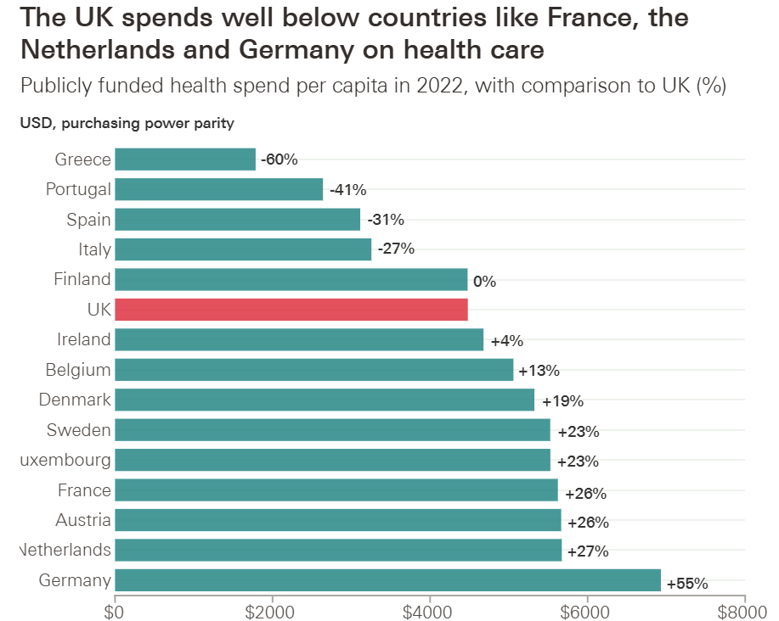
Notes:
https://www.health.org.uk/features-and-opinion/features/how-much-does-the-uk-spend-on-health-care-compared-to-europe?gad_source=1&gclid=Cj0KCQiAkoe9BhDYARIsAH85cDMsZHgHDIALeVHAxnNv7XnTehrE3Fhz4cpTz0Nkfb8cCEJAHQbhXFMaAotAEALw_wcB

Slide 9
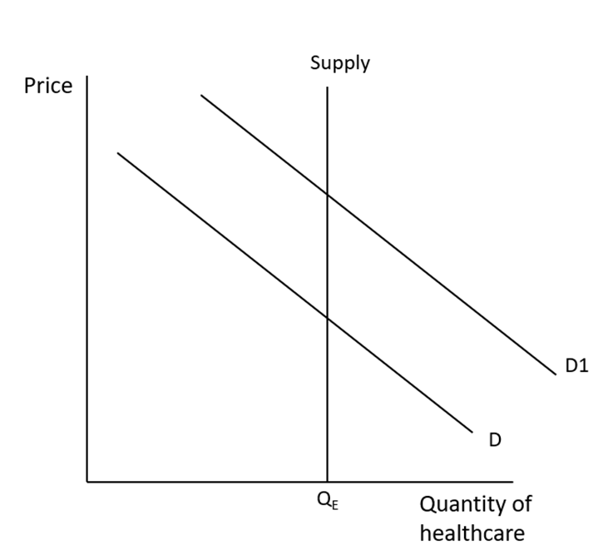
The result?

Slide 10
Rationing the unmet demand
By Denial:
Patients denied care they need, for example, deemed unsuitable or not urgent enough
By Selection:
Patients selected because of characteristics, for example, most likely to benefit from treatment
By Deflection:
Patients encouraged or turned towards another service, for example, private care
By Deterrence:
Patients deterred from seeking care, for example, barriers or costs put in place or not removed
By Delay:
Needs not met immediately, for example, wait for appointments or waiting-lists
By Dilution:
Services given to all but amount given reduced, for example GP appointments
By Termination:
System no longer treats certain patients, for example, cessation of cancer treatment

Slide 11
What are the options for health provision?

Slide 12

First-best theorem of welfare economics
The first fundamental theorem of welfare economics shows that in a first-best economy the equilibrium output will be Pareto efficient and therefore there is no need for change
The first-best model is not a description of reality, but it is used as a benchmark against which to evaluate policy

Slide 13
Healthcare
Healthcare will not meet the assumptions held about the first-best economy
  Perfect competition is unlikely
  Perfect information is very unlikely – individuals will know more about their individual health then the suppliers while suppliers will know more about treatments and interventions than patients
  There are externalities from healthcare – social benefit from individuals having better health
  Non-rational behaviour – playing contact sports or motorsports when the chance of injury is quite high or smoking despite the known health risks
While a first-best economy never really exists some markets and sectors can be much closer to it than others
Healthcare is as far away from it as we can get in reality

Slide 14
What if heath/social care was left to the free market?
ADVANTAGES
Efficiency and Innovation: Providers may compete to offer better services at lower costs, leading to improved efficiency
Consumer Choice: Provide consumers with more choices. This competition may lead to higher quality and more patient-centered care
Cost Control: Competition means providers may be incentivized to control costs to attract more patients
Incentives for Quality: Providers may focus on delivering high-quality care to attract and retain patients in a competitive market.
Free from Politics: Healthcare budgets would not be dependent on political factors

Slide 15
What if heath/social care was left to the free market?
DISADVANTAGES
Access Inequality: Those with higher incomes could afford better healthcare that those with lower incomes
Risk of Monopolies: Could lead to the dominance of a few providers. This could limit competition and hinder consumer choice
Adverse Selection: There might be a tendency for insurers to avoid covering those with pre-existing conditions or high-risk profiles
Neglect of Preventive Care: Profit-driven healthcare systems might prioritize lucrative procedures over preventive care
Potential for Exploitation: Those with chronic conditions or disabilities might be at risk of exploitation as market forces prioritize profit over the needs of these populations
Fragmentation of Services: Competition may lead to the fragmentation of healthcare services, making it challenging to coordinate care and manage chronic conditions effectively

Slide 16

The Wanless Report (2002)
This considered alternative options
Taxpayer funded (the current UK system)
Social insurance (where employees and employers make compulsory contributions towards healthcare and provision is also free at the point of need). This is often called the European or Bismarckian model of healthcare funding.
Private insurance (where individuals pay insurance fees to private companies, and then ‘claim’ when receiving treatment). This is the largest proportion of healthcare funding in the USA.
Out-of-pocket payments (where patients pay doctors or hospitals directly for treatment)
Rationing
Some combinations of these are possible – the current NHS is a combination

Slide 17
Final thoughts
Fundamental economic issue
  Need is greater than resources available
Pressures are going to continue to increase
Need to consider how to ration out excess demand (especially in a free at point of use system)
Are we likely to see increasing use of private health care or co-payment options?

