Slide 1

Business Economics UCAS Code: L101
Economics UCAS Code: 6H55

Slide 2



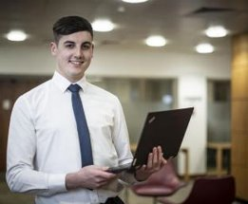

Our Economics Degrees are designed to give you the skills and experiences needed to start your career
First Year
Learn the fundamentals
Second Year
Developing processes & skills
Placement Year
Industrial Placement or Study Abroad
Final Year
Applying knowledge
Core & optional modules

Slide 3



Why study Economics at Ulster?
Personalised teaching support ​
Including small seminar groups and careers sessions built into the timetable.
Pathways to specialise​
You can choose modules in Accounting Business and Economics on Business Economics.​
You can choose modules in Finance and Economics on Economics.
Placements & internships​
In a typical year 50% of students will undertake a paid placement between 2nd Year & Final Year.

Slide 4

How will you be taught?
3 lectures & 3 seminars per week.
Usually, nine hours guided per week​.
30 hours self-guided.
Personal study support – Blackboard, library resources etc.​
Group work & project work in many year 1 & 2 modules​.
Assessment – most modules are 100% coursework​.
All modules use a blended learning approach.

Slide 5

Real world experience
Industry speakers
In 1st year the Economics in Practice has a range of guest speakers as do other modules​.
Industry practitioners participate in module delivery in the core 2nd year Entrepreneurship and Professional Practice module and optional modules in years 2 & 3.
Some modules are led by members of the Ulster University Economic Policy Center

Slide 6

Real world experience
Industry-led assignments
You will have the opportunity to do an industry-led assignment in the 2nd year Entrepreneurship and Professional Practice working on real-world projects with industry teams.

Slide 7



Slide 8
Finance and Investment Management UCAS Code: N321

Slide 9

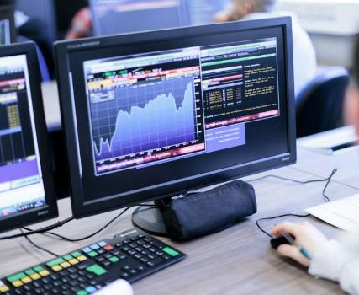

Why study Finance and Investment Management at Ulster?
What sets our course apart from other Universities?
Recognition
Accredited by the CISI and recognised by the CFA
Top class facilities
Including Financial Innovation Lab
Industry sponsored prizes, placements & internships
Annual prize giving with employer and professional body awards – brilliant opportunity to showcase our students to employers.

Slide 10

What will you learn
Learn the skills you need to start your career
An in-depth knowledge of financial principles, economic theory and the role of money, institutions, markets, and governing bodies
Investment skills and knowledge including statistics, financial decision making, modelling, portfolio management, financial reporting, risk management, ethics and regulatory requirements
Professional and key communication skills for the world of finance

Slide 11
BSc Hons Finance and Investment Management
Year 1 | Year 2 | Final Year
Quantitative Methods for Finance | Career Planning & Skills Development | Regulation and Ethics
Academic and Professional Skills | International Financial Reporting | Financial Statement Analysis
Microeconomic Principles | Corporate Finance | Insurance & Risk Management (OPTION)
Accounting for Financial Decision Makers | Financial Modelling | Behavioural Finance (OPTION)
Financial Institutions and Markets | Money and the Economy | Money, Banking and Financial Development (OPTION)
Financial Mathematics and Statistics | Principles of Investing | FinTech & Data Science (OPTION)
 |  | Sustainable Finance (OPTION)
 |  | Portfolio Management
 |  | Derivatives
 |  | International Finance
All modules are 100% coursework assessed

Slide 12


Slide 13


Slide 14



Belfast
Located within Belfast’s Cathedral Quarter, the bustling cultural centre of the city.
Modern, state-of-the-art facilities
Accommodates 15,500 students and staff

Slide 15
Courses
Courses are continually reviewed to take advantage of new teaching approaches and developments in research, industry and the professions.
Please be aware that modules may change for your year of entry.
The exact modules available and their order may vary depending on course updates, staff availability, timetabling and student demand.
Please contact the course team for the most up to date module list.
Notes:
Ensure you have the caveat on your slides – If your course changes it covers us in case someone goes back to you

